Slide 1
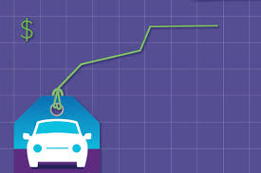
Project Report on : Used Car Price Prediction
PRESENTED BY:
VISHAL LAKHERA

Slide 2
Content
Overview.
Problem Statement.
Problem Understanding.
What is Car Price Prediction?
Importance of Car price prediction.
Exploratory data analysis.
Visualizations.
Analysis.
Data cleaning steps.
Model Building.
Saving the model and predictions from saved best model.
Conclusion.

Slide 3
OverView
In this particular presentation we will be looking on:
How to analyze the dataset of Car Price Prediction.
What are the EDA steps in cleaning the dataset.
Overall analysis on the problem.
Model building from train section.
Predicting Car Price for test section.

Slide 4
Problem Statement:
With the covid 19 impact in the market, we have seen lot of changes in the car market. Now some cars are in demand hence making them costly and some are not in demand hence cheaper. One of our clients works with small traders, who sell used cars. With the change in market due to covid 19 impact, our client is facing problems with their previous car price valuation machine learning models. So, they are looking for new machine learning models from new data. We have to make car price valuation model.

Slide 5
Problem Understanding
We are about to deploy an ML model for car selling price prediction and analysis. This kind of system becomes handy for many people.Imagine a situation where you have an old car and want to sell it. You may of course approach an agent for this and find the market price, but later may have to pay pocket money for his service in selling your car. But what if you can know your car selling price without the intervention of an agent. Or if you are an agent, definitely this will make your work easier.

Slide 6
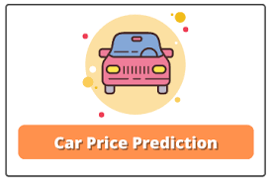
What Is Price Prediction ?
Prediction car prices are expected to help people who plan to buy a car so they can know the price range in the future, then they can plan their finance well. In addition, car price predictions are also beneficial dealers to know the trend of car prices.

Slide 7
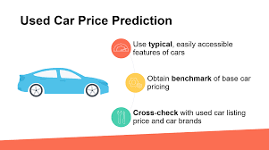
Importance of House Price Prediction
Car Price prediction, is important for both buyer and dealer. As it is important for both to determine the price to keep up with the market ,since fluctuations in market are very hard to preict this model will help both in better understanding of car market.

Slide 8
Exploratory Data Analysis
As a first step I have imported required libraries and I have imported both the datasets which I extracted using selenium.
Then I did all the statistical analysis like checking shape, nunique(unique value each column contains), value counts, info etc…..
Remove all the unneccesary data.
Did Data cleaning,like removing nan value, outlier,etc
Did feature engineeringwhereever required.

Slide 9
Exploratory Data Analysis
While checking for null values I found null values in most of the columns and I have used imputation method to replace those null values (mode for categorical column and mean for numerical columns).
In Id and Utilities column the unique counts were 1168 and 1 respectively, which means all the entries in Id column are unique and ID is the identity number given for perticular asset and all the entries in Utilities column were same so these two column will not help us in model building. So I decided to drop those columns.
Next as a part of feature extraction I converted all the year columns to there respective age. Thinking that age will help us more than year.
And all these steps were performed to both train and test datasets separately and simultaneously.

Slide 10
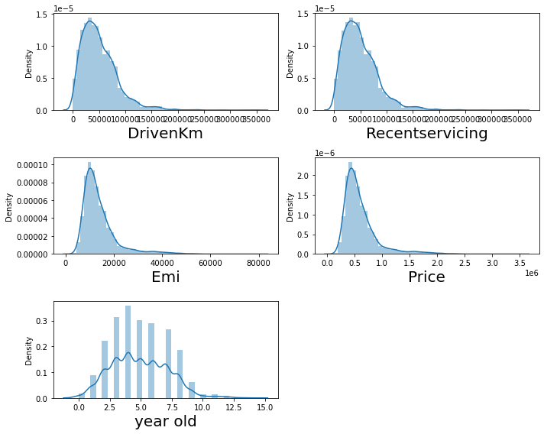
Visualization of numerical columns
Dist plot
All Column are skewd and are higher for lower value except 'year old ' column which is uniformaly distributed.

Slide 11
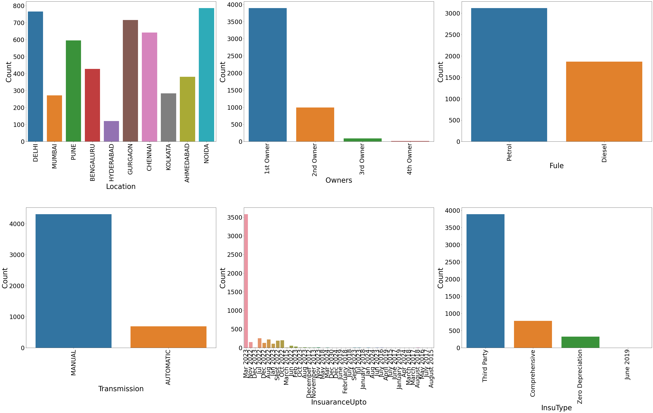
Vizualization of categorical columns
Count Plot

Slide 12
Observations
Noida have maximum no of used car on sale.
Most of the car falls into category '1st owner' i.e single user before selling.
Car with Petrol as Fule Type are more in numbers , which indicates that maybe customer usually prefer petrol car.
Most of the car which are on sale are Mannualy operated one ,automatic car are usually expensive.
Most of the car have been insuared upto march 2023
Most No. of car have 3rd party insuarance.

Slide 13
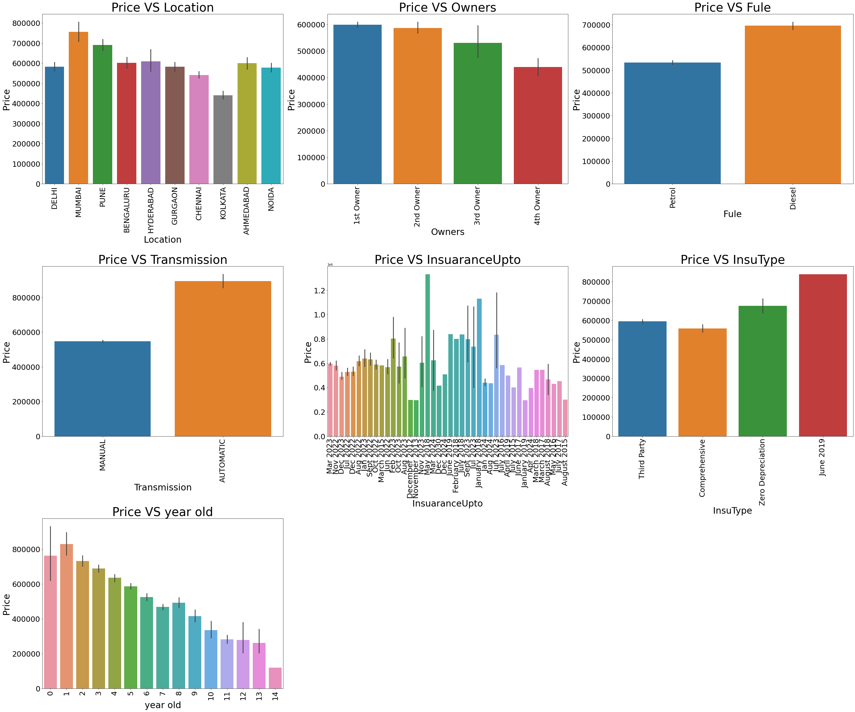
Comparison Between feature and Target(Barplot)

Slide 14
Observation
Cars manufactured in mumbai have higher price then other, whereas in kolkata price is cheapest.
Car who have 1st or 2nd owner have higher price as they are well maintained.
Car having fule type as diesel have higher price.
Automatic cars are costlier than other.
Cars which have been insuared upto May 2018 have higher price.
Cars having insuarance type as "Zero Depriciation" have higher price.
New cars have higher Price.

Slide 15
Analysis
I have used count plot for each pair of categorical features that shows the relation with the sale price.
And also for continuous numerical variables I have used bar plot to show the relationship between continuous numerical variable and target variable.
I found that there is a linear relationship between continuous numerical variable and Price.

Slide 16
Data Cleaning Steps
In my datasets I found null values, outliers and also skewness.
I have used imputation method to replace null values. To remove outliers I have used z-score method. And to remove skewness I have used yeo-johnson method.
To encode the categorical columns I have use Label Encoding.
Use of Pearson’s correlation coefficient to check the correlation between dependent and independent features.
Also I have used standardization. Then followed by model building with all regression algorithms.

Slide 17
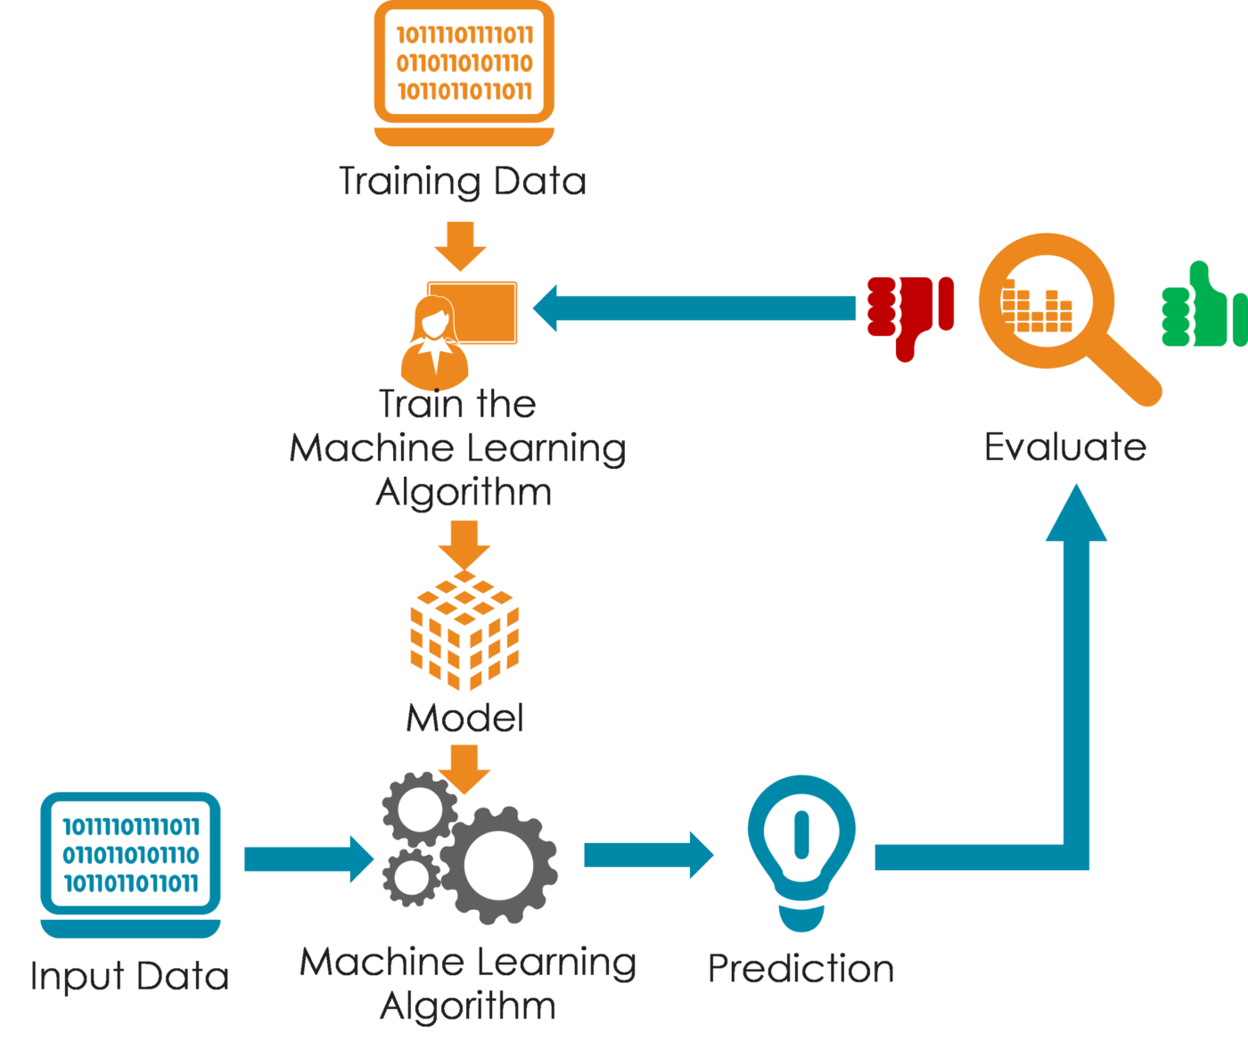
Model Building
Since Price was my target and it was a continuous column so this perticular problem was regression problem. And I have used all regression algorithms to build my model. By looking into the difference of r2 score and cross validation score I found GradientBoostingRegressor as a best model with least difference. Also to get the best model we have to run through multiple models and to avoid the confusion of overfitting we have go through cross validation.

Slide 18
Below are the list of regression algorithms I have used in my project.
RandomForestRegressor
XGBRegressor
ExtraTreesRegressor
GradientBoostingRegressor
DecisionTreeRegressor

Slide 19
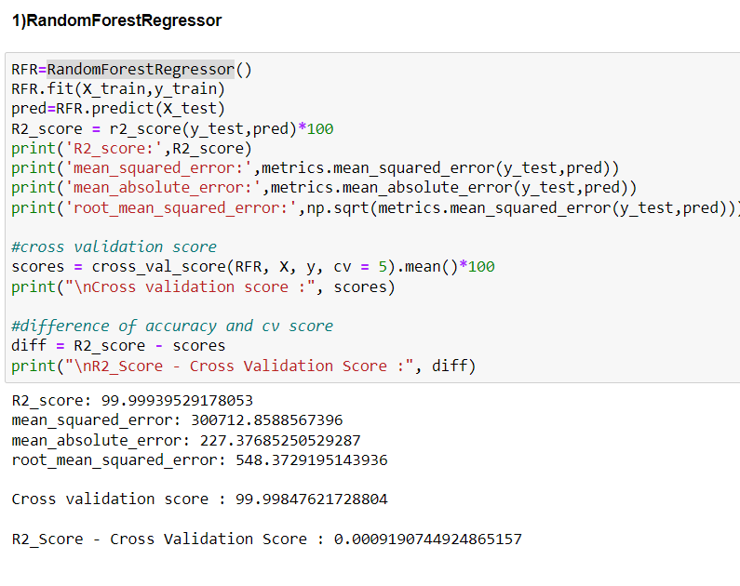
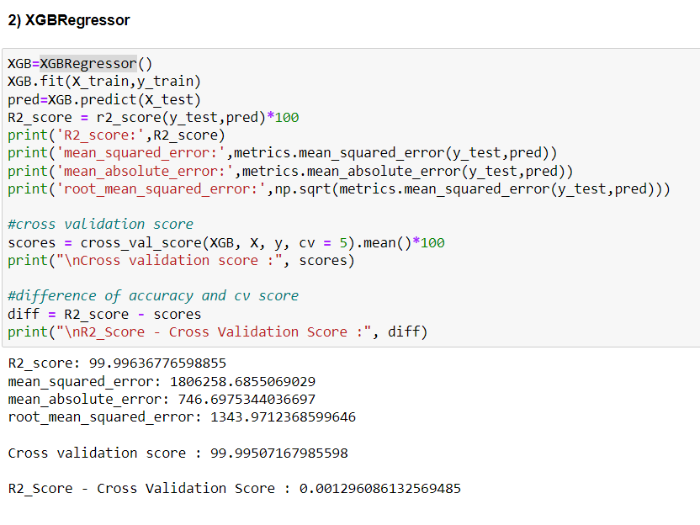
Different Model Performance:

Slide 20
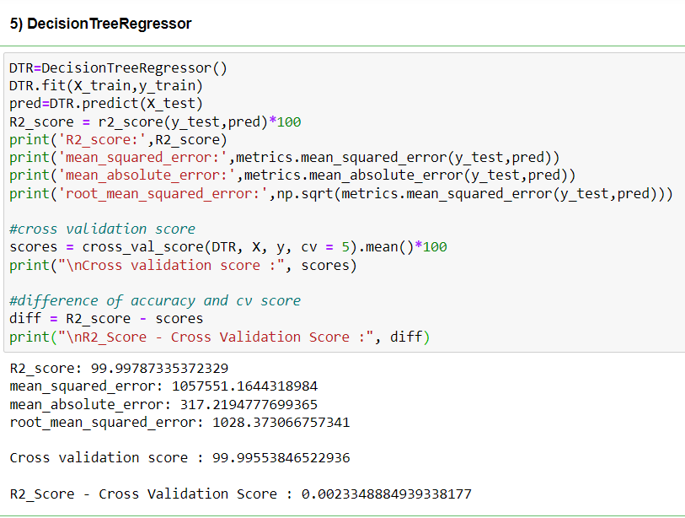

Slide 21
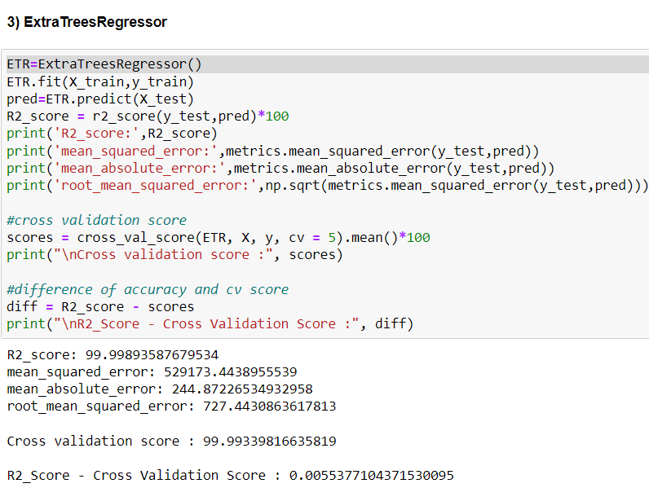
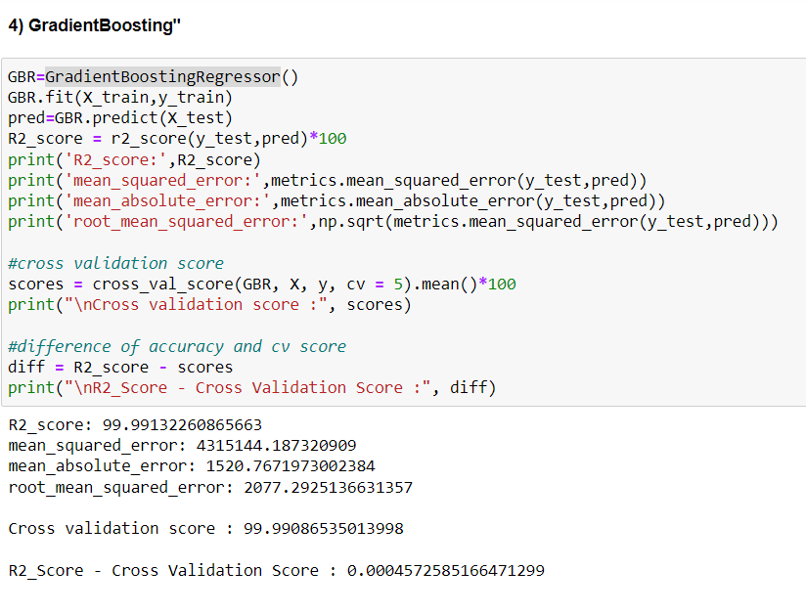

Slide 22
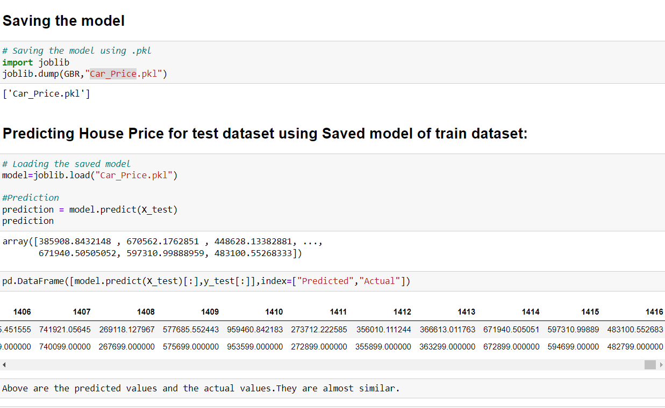
Saving the model and predictions using saved model
I have saved my best model using .pkl as follows.
Now after saving the best model, loading my saved model and predicting the test values.

Slide 23
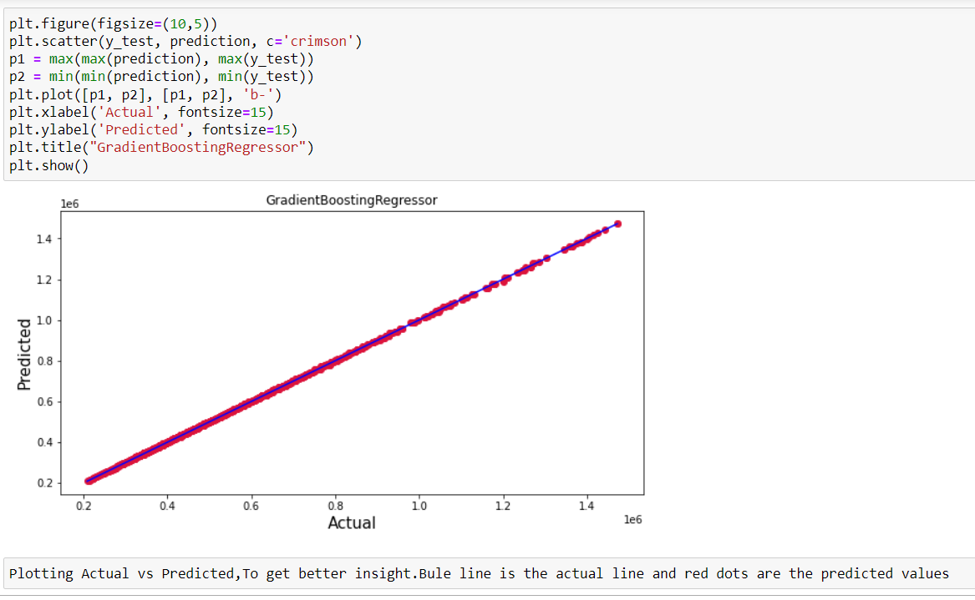
I have predicted the SalePrice for test dataset using saved model of train dataset, and the predictions look good.

Slide 24
Conclusion
In this project report, we have used machine learning algorithms to predict the Car prices.
We have mentioned the step by step procedure to analyze the dataset and finding the correlation between the features. Thus we can select the features which are not correlated to each other and are independent in nature.
We calculated the performance of each model using different performance metrics and compared them based on these metrics.
After applying different algorithm I found Gradient boosting regressor to be best fit model.
This model will help buyer, user and dealer to get better understanding of car market and predict the price for different cars.

Slide 25


